Slide 1

Image Encryption Process based on Chaotic Synchronization Phenomena
By S P Sharan – 108118095 – ECE A

Slide 2

Abstract
This project presents an image encryption scheme, which uses a chaotic True Random Bits Generator (TRBG).
The chaotic TRBG is based on the coexistence of two different synchronization phenomena.
The first one is the well-known complete chaotic synchronization
while the second one is a recently new proposed synchronization phenomenon, the inverse p-lag synchronization.

Slide 3

Overview of Project
This coexistence is observed in the case of two mutually coupled identical nonlinear circuits. The nonlinear circuit, which is used, produces double-scroll chaotic attractors.
The initial conditions of the coupled system and the values of the circuit’s parameters serve as the private key of the proposed cryptographic scheme.
This bit-sequence has then been used to encrypt and decrypt gray-scale images.

Slide 4

True Random Number Generators (TRNGs)
Generators that produce random sequences can be classified into three types:
True Random Number Generators (TRNGs)
Pseudo-Random Number Generators (PRNGs)
Hybrid Random Number Generators (HRNGs)
TRNGs take advantage of nondeterministic sources, which come from an unpredictable natural process in a physical or hardware device that can output a sequence of statistically independent data.

Slide 5

Cryptography Scheme
Idea of our method is to encrypt a gray-scale image via a chaotic True Random Bits Generator (TRBG), which is based on the interaction between two mutually coupled identical chaotic circuits.
According to a binary sequence generated from the chaotic generator, the pixels of the gray-scale image XOR-ed to the predetermined keys.

Slide 6


Types of Synchronization
Complete Synchronization
The most well-known type of synchronization is the complete or full synchronization, in which the interaction between two identical coupled chaotic systems leads to a perfect coincidence of their chaotic trajectories
$$x_{1}\left(T\right)=x_{2}\left(t\right) as t→∞$$
Inverse $π$-lag Synchronization
When a coupled system is in a phase locked (periodic) state, depending on the coupling factor and it can be characterized by eliminating the sum of two relevant periodic signals ($x_{1}$ and $x_{2}$) with a time lag which is equal to $\frac{T}{2}$, where $T$ is the period of the signals $x_{1}$ and $x_{2}$
$$x_{1}\left(t\right)=−x_{2}\left(t+τ\right), where τ=\frac{T}{2}$$

Slide 7
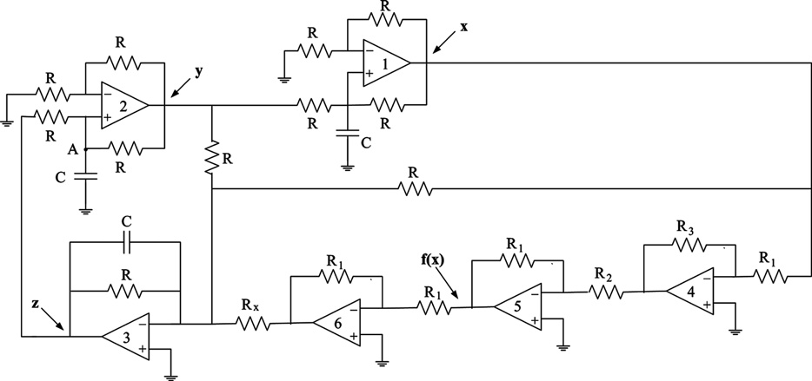
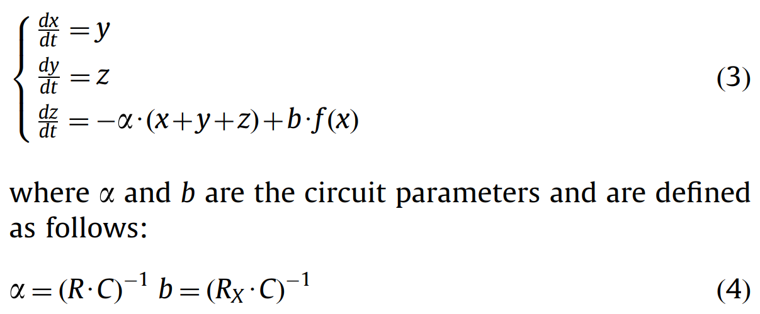
The Chaotic True Random Bits Generator
The autonomous nonlinear circuit (shown in figure 1), which has been used, can produce double-scroll chaotic attractors.
This has the characteristic of two attractors, between which the process state will oscillate.
The state equations of the chosen system are the following (shown in figure 2)
Explanation
Op-Amp 1 – Integrator
Op-Amp 2 – Integrator
Op-Amp 3 – Adder

Slide 8
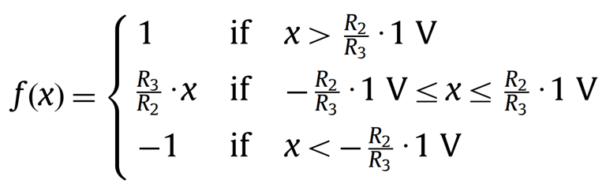

Saturation Function
The function f(x) in system’s equation is a saturation function which represents the voltage at the output of the operational amplifier numbered as “5” and is defined by the following expression
So, the function f(x) is implemented in such a way that the saturation plateaus are $±1$ and the slope of the intermediate linear region is $k=\frac{R_{3}}{R_{2}}$.

Slide 9
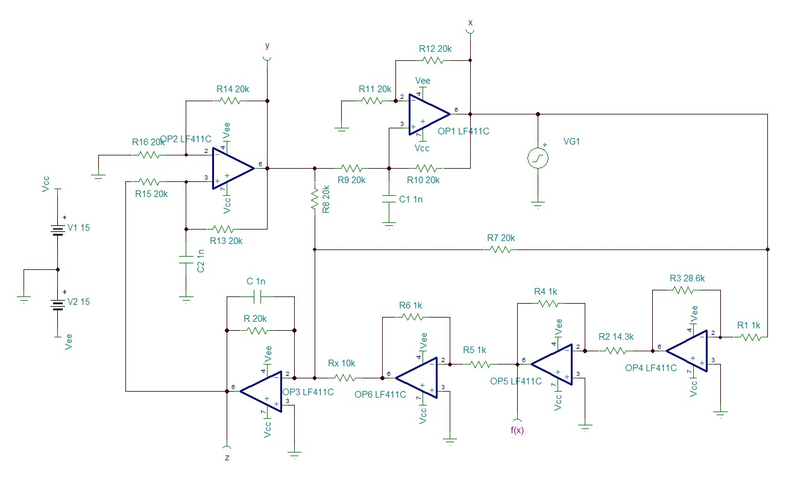

Slide 10
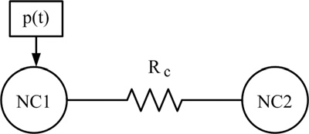
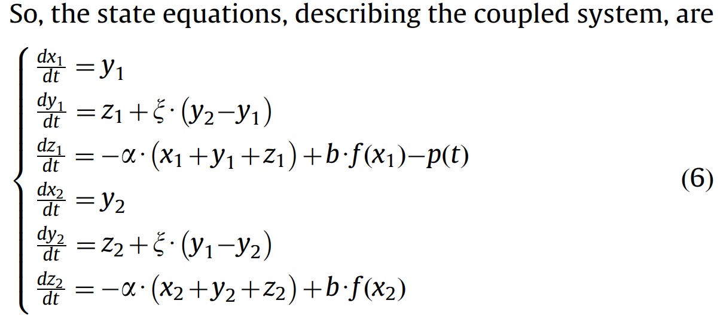

Mutually coupled nonlinear circuits
As it is previously mentioned, the proposed TRBG uses a system of two mutually coupled identical double-scroll chaotic circuits of this type.
For this reason, the coupling of the identical nonlinear circuits is achieved via a linear resistor RC connected between the nodes A of each circuit.
The first three equations of system (6) describe the first of the two coupled identical nonlinear circuits (NC1), while the other three describe the second one (NC2).
The coupling coefficient is $ξ=\frac{R}{R_{c}}$ and it is present in the equations of both circuits, since the coupling between them is bidirectional.

Slide 11
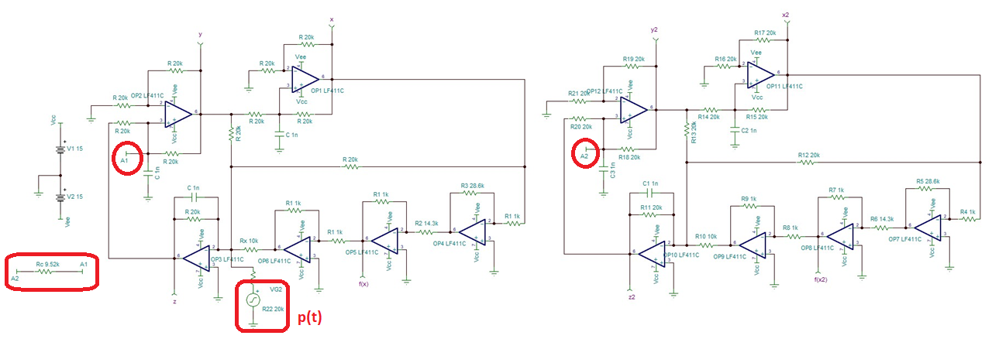
Mutually coupled nonlinear circuits

Slide 12
The chaotic true random bits generator scheme
p(t) is an external source which produces pulses that are necessary, as a perturbation, for changing the initial conditions of the system and therefore the synchronization state of the coupled system (inverse p-lag or complete synchronization).
In detail, this source produces a pulse train of amplitude 0.7 V having a duty cycle of 4%. Thus, the pulse duration is 2 ms, while the period of the pulse train is 50 ms.

Slide 13
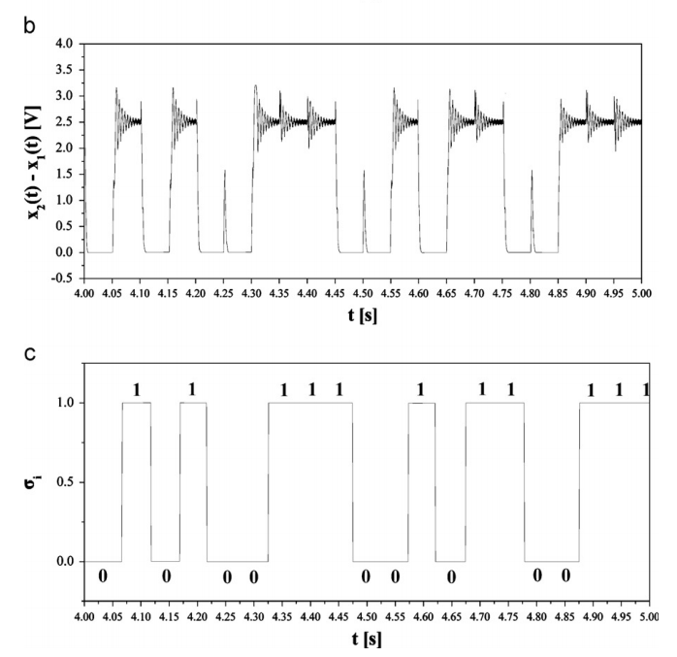
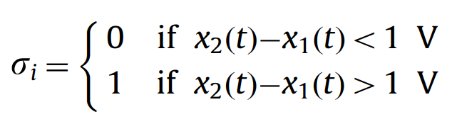

Bit-Quantization and De-Skewing
In the second block of the proposed TRBG, the two different levels of the output signal $[x_{2}(t)–x_{1}(t)]$ are quantized to ‘‘0’’ and ‘‘1’’ according to the following equation

Slide 14

De-Skewing Techniques
It is known that a natural source of random bits may not give unbiased bits as direct output.
We must extract unbiased bits from a defective generator with unknown bias. These are called de-skewing techniques.
Done by converting the bit pair ‘‘01’’ into an output ‘‘0’’, converting ‘‘10’’ into an output ‘‘1’’, while the pairs ‘‘11’’ and ‘‘00’’ are discarded.
Decreases throughput because of generating approximately 1 bit from 4 bit.

Slide 15


Encrypting the Image
Step 1:
The scheme finds the pixel size MxN of the image, where M and N represent row and column of the image.
The pixels are arranged by order from left to right and top to bottom. Then an image data set, in which each element is the decimal gray-scale value of the pixel (0–255), is produced.
Finally each decimal value is converted to a binary equivalent number and in the end a one-dimensional matrix B is produced.
Step 2:
The matrix A which is a binary sequence produced by the chaotic TRBG, and the above-mentioned matrix B produces a third one-dimensional matrix C by using the XOR function: $C=A⊕B$.
Step 3:
The produced in the previous step matrix C is converted to the encrypted image by the inverse process of step 1.
And follow the Inverse Operation for decryption

Slide 16
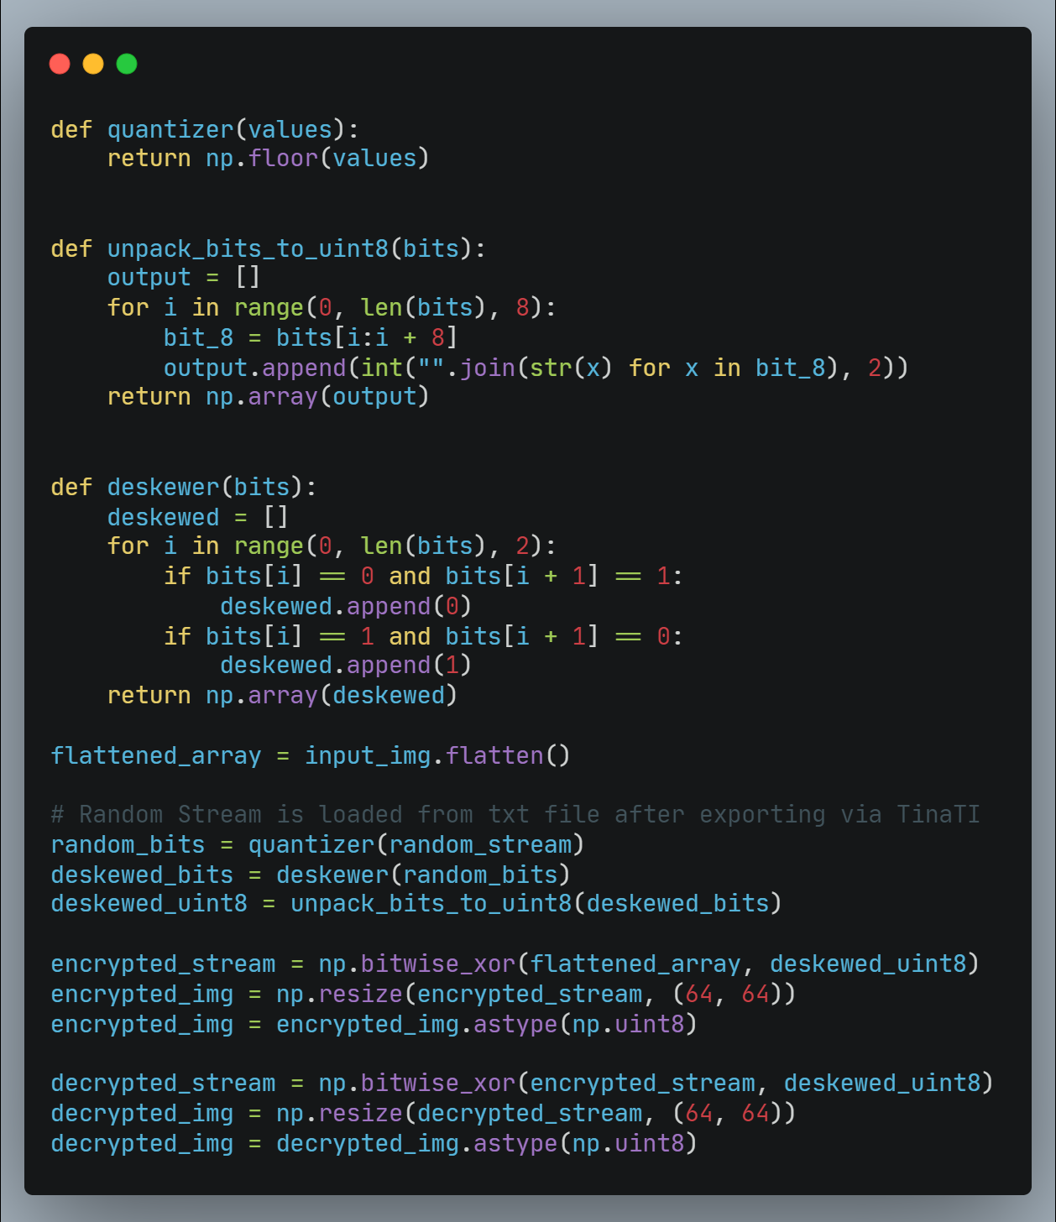
Implementation
The was made in Tina TI and simulations run over night as an estimated of 131072* data points are required.
The output obtained was exported to a txt file and parsed in python for processing.
Python Modules used are: Numpy (array handling), Open-CV (picture handling)
* $→$ (64x64 image) $×$ (8-bit representation) $×$ (4-bit overhead)

Slide 17
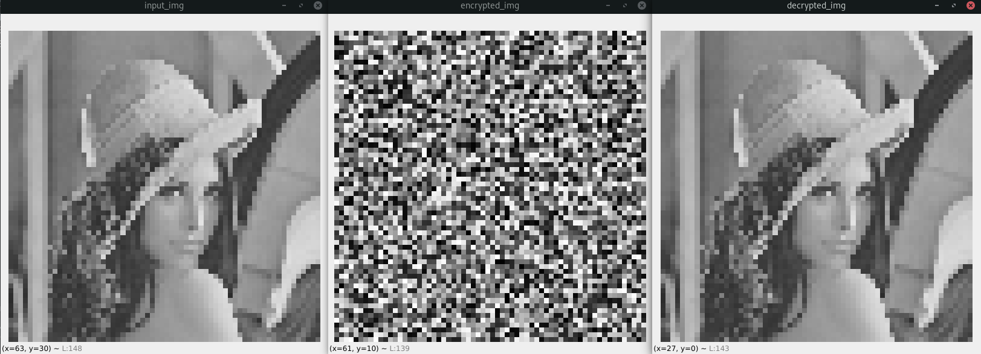
Final Outputs
Input Image
Encrypted Image
Decrypted Image

